Slide 1

The Gateway Group
www.thegatewaycorp.com
Notes:
A straight opening: the company, its positioning line from the site, and the basic facts. No concept, no setup.

Slide 2
Founded in 1997, Gateway Group is a privately held global enterprise headquartered in India and The Netherlands, with operations spanning across five continents.
Today, the Group builds and holds successful businesses across industries, through a diversified portfolio of independent operating companies:
Publicly listed entities
Wholly owned subsidiaries
Joint ventures
Across the Group, one principle remains constant:
Engineering Excellence is our DNA.
Strategic investments
Notes:
The homepage introduction, verbatim, restructured: identity as the statement, the four portfolio types as a row, and the operating principle as the closing line.

Slide 3
Three Decades. One Legacy.
1997
40+
2
15
FOUNDED
OPERATING COMPANIES
PUBLIC LISTINGS
COUNTRIES ONGROUND PRESENCE
2,000+
14
12
Zero
BRILLIANT TEAM
NATIONALITIES
INDUSTRIES
DEBT · SELF-FUNDED SINCE 1997
Notes:
Neutral facts, no adjectives. The ember cell is the one a risk team cares about most: no lender and no outside shareholder can force a change of course.

Slide 4
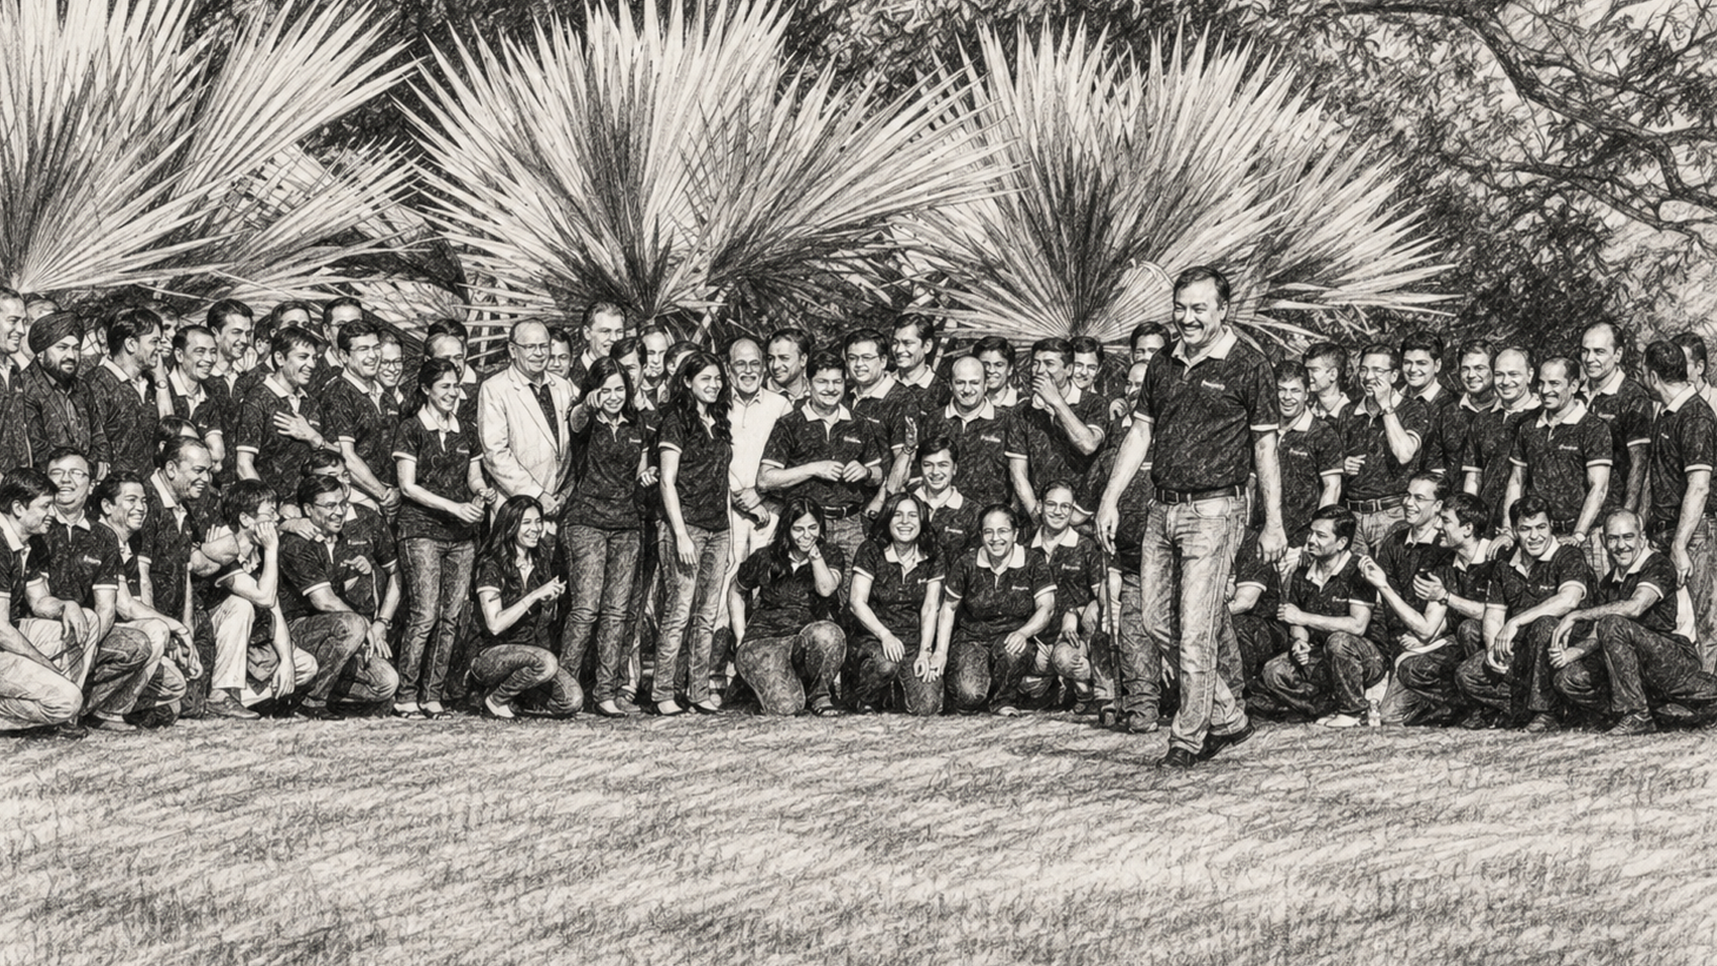
Building an Organization that will breathe for over 100 years and will leave a legacy for generations to follow.

Slide 5

A tower stands on one trunk, and falls with it.
We built Gateway like a banyan tree, wider and stronger every year.

Slide 6
Group Structure.
Gateway Group
Holding company · Ahmedabad and Zoetermeer
OPERATING COMPANIES
PUBLIC MARKETS
INVESTMENT ARM
Independent companies
Two listed companies
TGC Capital Partners
Wholly owned subsidiaries, joint ventures and strategic investments across 15 countries.
NINtec Systems Limited, on the Main Board of both Indian exchanges. NSE: NINSYS · BSE: 539843. TGIF, BSE: 544175.
The group’s Strategic Investment Arm
Notes:
The homepage introduction, verbatim, restructured: identity as the statement, the four portfolio types as a row, and the operating principle as the closing line.

Slide 7
Three Ways to Become a Part of Gateway
Whichever way a company joins, it inherits the same thing on day one:
The Gateway Way, delivered to its doorstep.
01
02
03
BUILT INSIDE
JOINT VENTURES
STRATEGIC INVESTMENTS
Companies founded within
the group and held outright,
from the first line of code.
Shared ownership with
founders and partners
who lead their own markets.
Positions taken where the
group’s operating knowledge
gives it an edge.

Slide 8
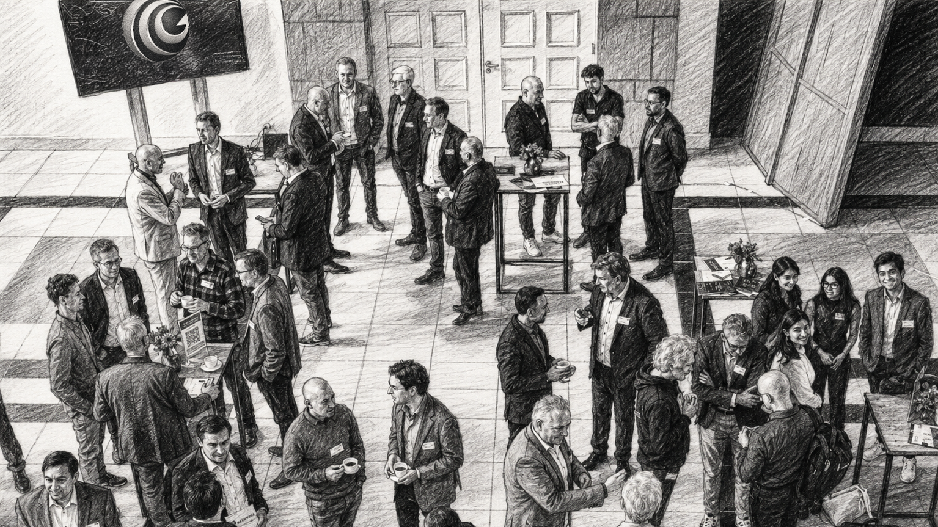
Great businesses are built the Gateway Way.

Slide 9
The Gateway Way.
One system, six disciplines, installed in every company
the group builds or backs, from day one.
01
ENGINEERING
STRATEGY
02
Every problem
yields to method.
Know where to play.
Be known for it.
03
CAPITAL
REACH & NETWORK
04
ONE SYSTEM
SIX DISCIPLINES
Fund the future
without mortgaging it.
Doors open faster
when the house is inside.
05
PEOPLE
VALUES
06
Businesses are built
by builders. We grow builders.
A belief is proven when
honouring it costs you.
Notes:
The vision line, verbatim. Let it sit; the structure slides that follow show how it is pursued.

Slide 10
40+ companies.
Independently run companies and strategic investments unified by engineering discipline.
AI-Native SaaS · 7
Third Law · Gateway Digital AI · Inamo · Sovilo · Oriiion · Yemo · Relay
Automotive & Circular Economy · 8
AutoFacets · AutoDAP · iGarage · AnalyzeMyCar · CarSale24 · AutoMPS · Dismanto · Smilee
Engineering, Consulting & Digital Services · 4
Gateway Digital · NINtec Systems · Alvarium · TecBridge
Cyber Security · 3
G'Secure Labs · NordicSOC · Verjitech
FinTech · 3
TGISME · Klar · FinFacets
Logistics, Energy & Agri · 5
FlowNxt · DiLX · GLEX · Global Trading Solutions · TGIF Agri
Health & Biotech · 3
Lifeness · Datatopia · BugWorks
Workplace & EventTech · 3
ZaveIT · Tappin · Veriate
Consumer, Retail & Media · 3
Leap · Gateway Animedia · Strong Nation
Notes:
Nine clusters covering all 39 companies. Smilee sits with automotive, Global Trading Solutions with the energy and logistics cluster, and Tappin's EventTech named in the workplace row.

Slide 11
Trusted AI & Software Engineering partner for Global Enterprises.
888 Gaming
Bandel
Green Source
KPN
Partly
Sytner Group
ABR Reservdelar
Biluppgifter
Groupauto
Kverneland Bil
PartsFinder365
TecAlliance
AD Finland
Broman Group
GSF Car Parts
Limitless
Pertemps
Telegraaf
AD Sverige
Budweg
Hitachi
LKQ
PilotGo
TEMOT International
Agrifirm
CABAS
HL Group
McAfee
Pioneer
Topmotive
AMT Automotive
Cox Automotive
Holman
MECA
PostNL
Toshiba
ARI
Delespesialisten
HSBC
MEKO
Proactive Gaming
Toyota
Arrend Leasing
Digia
IKEA
Mekonomen
RøhneSelmer
TÜV NORD
Atos
Ebusco
Inter Cars
Mercantile
Scania
Tymewear
Atoy
Elsevier
Kaha
Michelin
Select AG
Veng
Auto-Guru
Euromaster
Katsastus
Mobivia
ServiceNext
Veolia
AUTODOC
Formula Automotive
Keyloop
Motoral
Skruvat.se
Vierol
AutoIT
Friesland Lease
KGK
Navitrans
Smoods
Visa
AutoPass
FTZ
Knovel
Neste
Solware Auto
Vodafone
Autotelex
Ghistelinck
Koivunen
Nuts Group
Standard Bank
Vrooam
Avis
GO Parts
Koskamp
Örum
Svenska Travsport
Wolters Kluwer
Notes:
The register of counterparties who did their own diligence and stayed. Names, not logos: it reads as a record, not an advertisement.

Slide 12
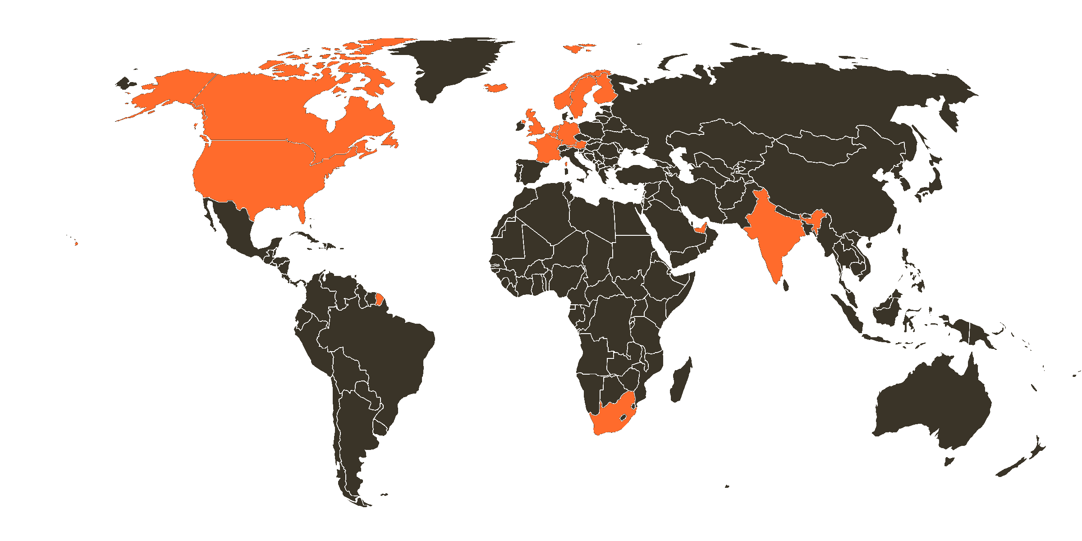















On the ground in 15 countries.
EUROPE · 10
AMERICAS · 2
ASIA-PACIFIC · 1
MIDDLE EAST · 1
AFRICA · 1
Austria
Iceland
Canada
India
UAE
South Africa
Belgium
Netherlands
United States
Finland
Norway
France
Sweden
Germany
United Kingdom
Notes:
The office network in the style of the site's presence map: office locations in ember, arcs routed through the two head-office hubs, the fifteen countries with their flags as the caption.

Slide 13
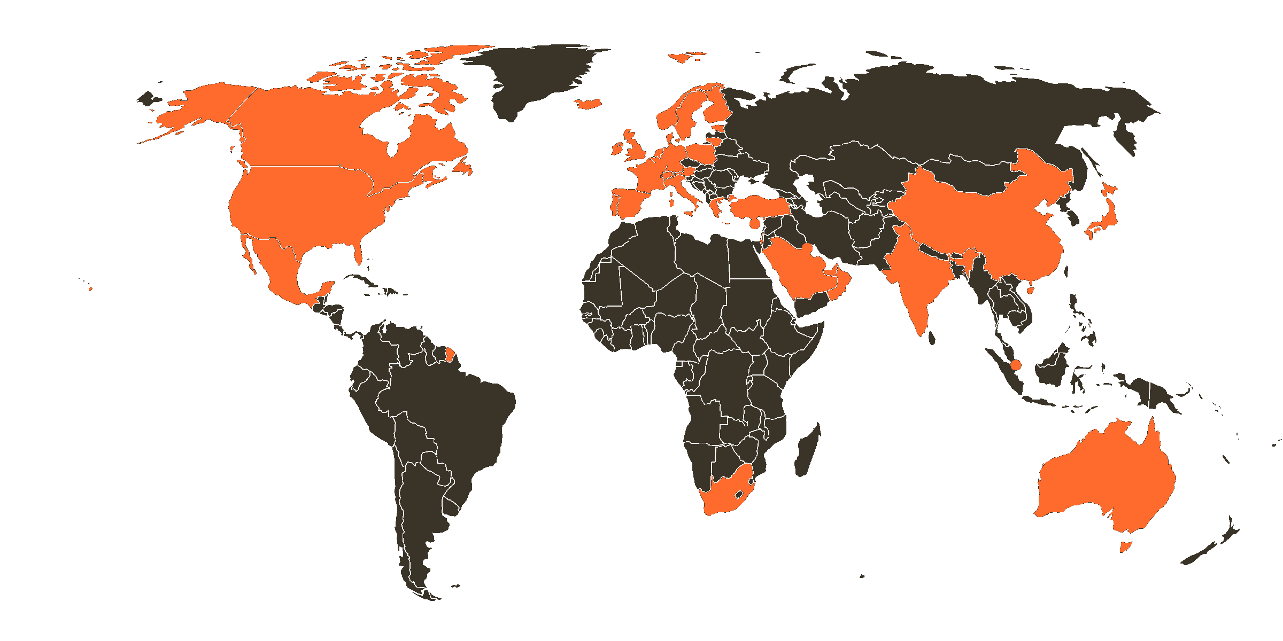
























Customers across 39 countries.
EUROPE · 22
MIDDLE EAST · 8
ASIA-PACIFIC · 5
AMERICAS · 3
AFRICA · 1
Austria
France
Lithuania
Spain
Bahrain
Turkey
Australia
Canada
South Africa
Belgium
Germany
Luxembourg
Sweden
Israel
UAE
China
Mexico
Cyprus
Greece
Netherlands
Switzerland
Kuwait
India
USA
Denmark
Iceland
Norway
UK
Oman
Japan
Estonia
Ireland
Poland
Qatar
Singapore
Finland
Italy
Portugal
Saudi Arabia
Notes:
The client footprint in the style of the site's presence map: the 39 countries served, from the homepage map's own data, in neon green, each named with its flag beneath the map.

Slide 14
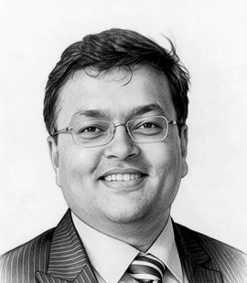
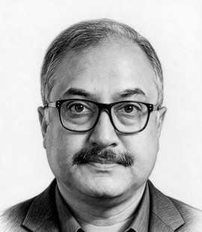
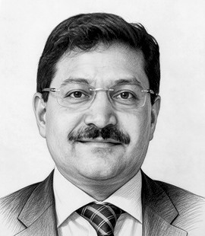
Where Entrepreneurship is Celebrated.
Three founders, together since the group's first years.
FOUNDER & CHAIRMAN
CO-FOUNDER & BOARD MEMBER
CO-FOUNDER & BOARD MEMBER
Niraj Gemawat
Indrajeet Mitra
Vipin Moharir
Founder, Chairman & Group CEO · Managing Partner, TGC Capital Partners
CEO, AutoDAP · CEO, Gateway Digital · CEO, Global Delivery & Operations
Group Chief Strategy Officer · CEO, Gateway Digital Benelux · Partner, TGC Capital Partners
Sets the Group’s strategic direction across its ventures and brands. A people-first leader who listens, stays connected, and remembers the people, journeys, and families behind the organization.
The tech brain of the Group, hands-on, detail-driven, and curious about how things can work better. If it involves technology, he dives in, collaborates, challenges ideas, and shapes the solution.
Drives strategy, execution, and outcomes across the Group, with a sharp focus on growth and Buy & Build. Brings clarity to complex decisions and turns ambition into action.
Notes:
Factual leadership panel: current roles from the site's leadership section, professional background from their public profiles. The institutional point stands on its own: the same three founders, still in executive roles.

Slide 15
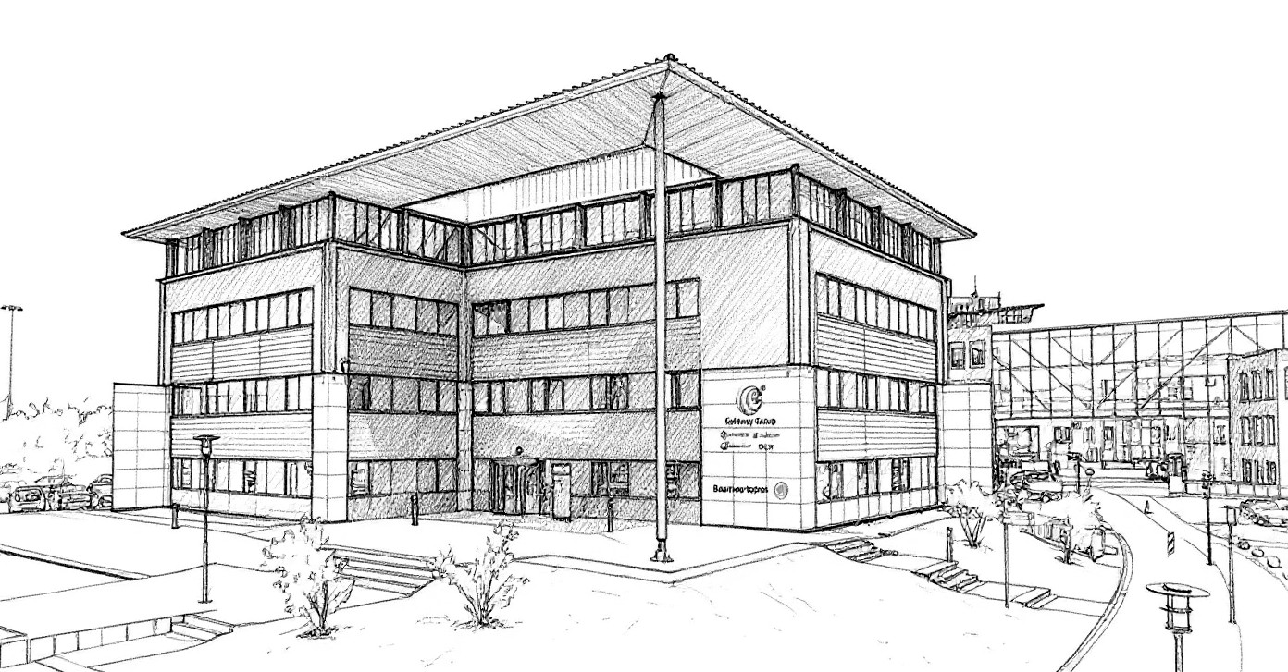
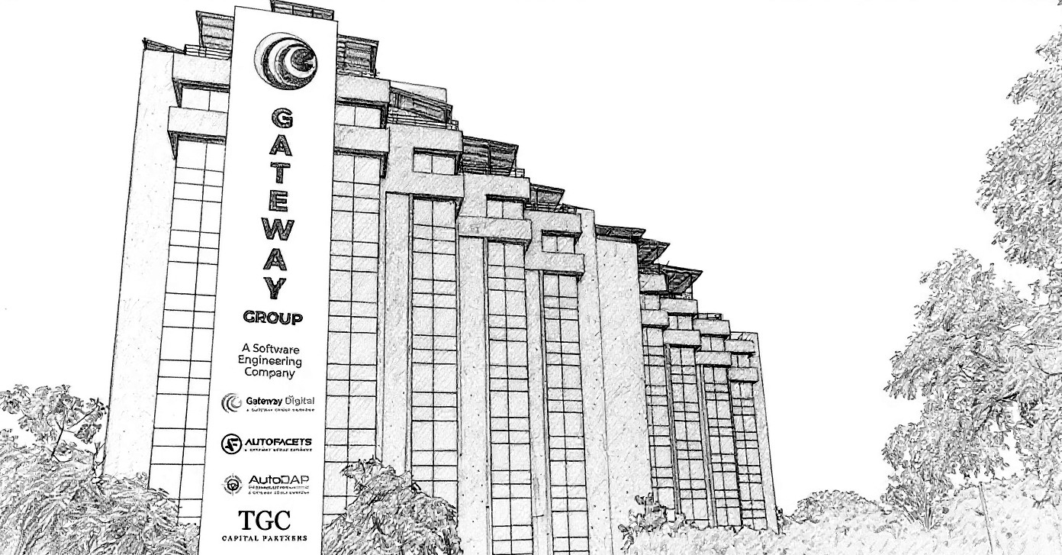
This is where the Magic Begins
NETHERLANDS · HEAD OFFICE
INDIA · HEAD OFFICE
GATEWAY GROUP | ZOETERMEER, THE NETHERLANDS
GATEWAY GROUP | AHMEDABAD, INDIA
Notes:
Stills of the two head offices, taken from the film on thegatewaycorp.com; addresses and phone numbers beneath each.

Slide 16
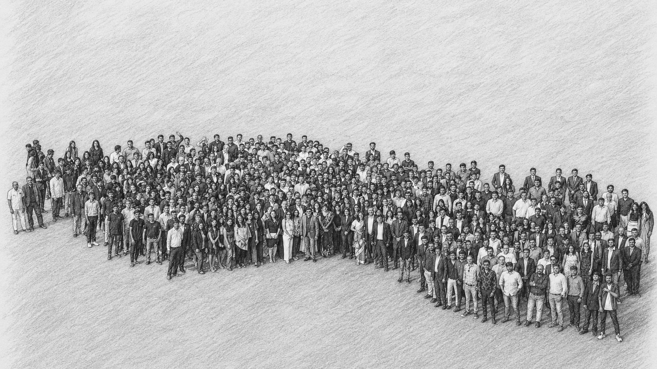
Our Belief System.
Most companies will tell you what they do. Here we tell you what we believe, and exactly what to expect from us once we walk the road together.
Be good, do good,
and good will happen.
Notes:
The axiom, verbatim, on the stone field the site uses. The presenter only has to read one sentence aloud; the next two slides carry themselves.

Slide 17
What Powers the Business.
Five beliefs that define the group: how it is built, funded, led, and why it is designed to succeed even in challenging times.
I
Burn the bridges.
Commitment is only commitment when there is nothing to fall back on.
II
Everyone here is an entrepreneur.
We were founded by one entrepreneur. We are run by hundreds of them.
III
Ten a day, every day.
We would rather earn ten every day than ten thousand once. Durable beats dramatic, in revenue and in everything else.
IV
The customer comes before the
margin, and before us.
The order matters, and it is not negotiable: the customer, then the work, then the margin, then us.
V
When times are good, even
donkeys can run.
Anyone grows in a rising market. The hard years tell the donkeys from the horses, and the hard years are the ones we are built for.
Notes:
First Tablet, verbatim: each belief with the page's own first explanation beside it. Nothing here needs a warm-up; read any row and it lands.

Slide 18
What shapes our team within.
Five beliefs about our team: how promises are honoured, how dreams are shared, how disagreements are resolved, what the group owes its families, and why nobody is allowed to become complacent.
A promise made is a promise honoured.
A commitment made on a call in one country is a commitment the whole group keeps.
VI
Together, we dream the same dream.
Ambitions are personal. Direction is shared. We put both on the table and argue until the dream belongs to everyone.
VII
F = C · P = S
Frustrated, so you Communicate. And you communicate the Solution, not the Problem.
VIII
One roof, many households.
Fifteen countries, one culture: a handshake means the same thing in Zoetermeer as it does in Ahmedabad.
IX
Success is practised, never possessed
Twenty-nine years and forty companies are not a guarantee. They are a habit, renewed every morning
X
Notes:
Second Tablet, verbatim. If one row is read aloud, make it IX: fifteen countries, one culture, a handshake meaning the same thing everywhere.

Slide 19
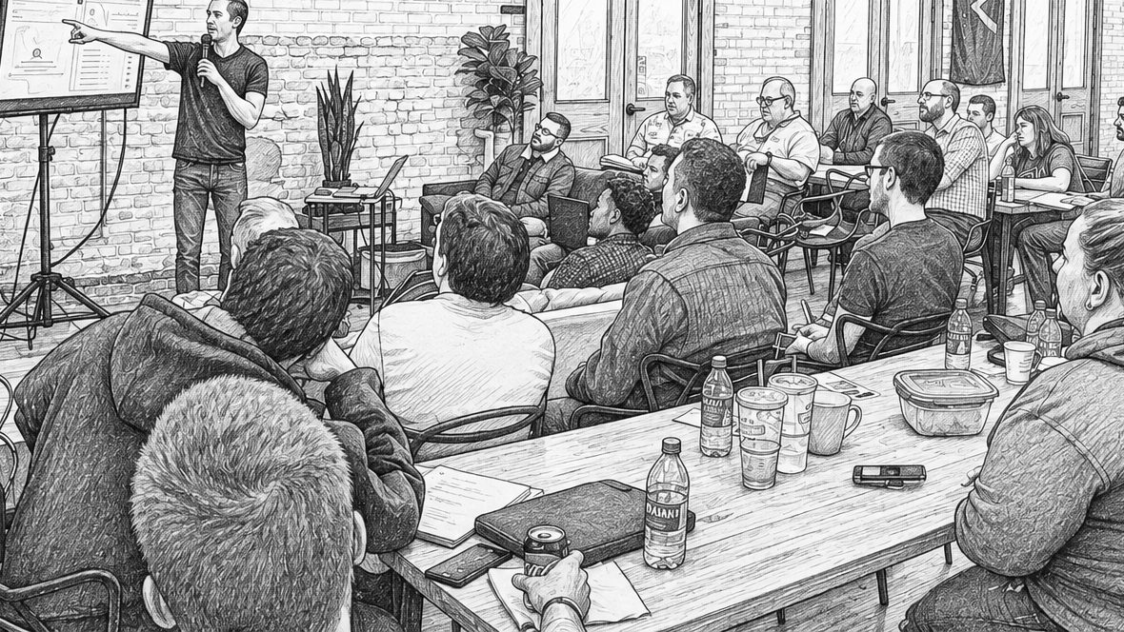
We have never believed that an Organization is built
with code, capital, or a clever idea. It is built with character.
Notes:
The ethos page, verbatim, placed before the client register.

Slide 20
Governance, Trust and Recognition.
CERTIFICATIONS AND RATINGS
AWARDS AND RECOGNITION
ISO 9001:2015 · Quality Management
National MSME Corporate Excellence Award
29th, Microsoft's 50 Most Competent Partners
Independently certified by Alcumus ISOQAR for the design, development, testing and maintenance of software engineering solutions.
Presented by the Honourable Union Finance Minister / President of India.
Gateway Technolabs, on ten gold and five silver competencies.
ISO 27001:2022 · Information Security
President's Choice Award, GESIA
G'Secure Labs · Cybersecurity & Resilience
Certified information security management system covering the group's software engineering delivery, audited by Alcumus ISOQAR.
For excellence in global delivery, 8th GESIA Annual ICT Industry Awards.
Winner, Threat Detection & Response Excellence.
SMERA SME 1 · Highest credit-worthiness
GESIA Annual Awards 2024
AutoDAP · CLEPA Innovation Awards
SMERA Performance & Credit Rating for NINtec Systems Limited, the highest grade in relation to other SMEs.
Best SaaS Product Solution, Platinum.
Second place, CLEPA 2020 SME Environment special prize.
Strongest in Finland · Gold Certificate
Best Mobile Development Company
AutoDAP · TiE50 Awards
Gateway Digital Oy, tied to Rating Alfa credit rating and sustained financial performance.
GESIA, in the large-company category.
Startup recognition for the automotive data platform.
UC Sigill · Highest creditworthiness
Best Software Company Award
AutoDAP · Top Vehicle Data Startups
Gateway Digital Sweden AB, at UC's highest risk class. UC AB, Sweden's leading credit-information agency.
Gujarat State, West India.
For vehicle-data intelligence built for the aftermarket.
Notes:
The recognition section from the group's home page: independent certifications, independent credit ratings, and the award record. Every line is the site's own wording.

Slide 21
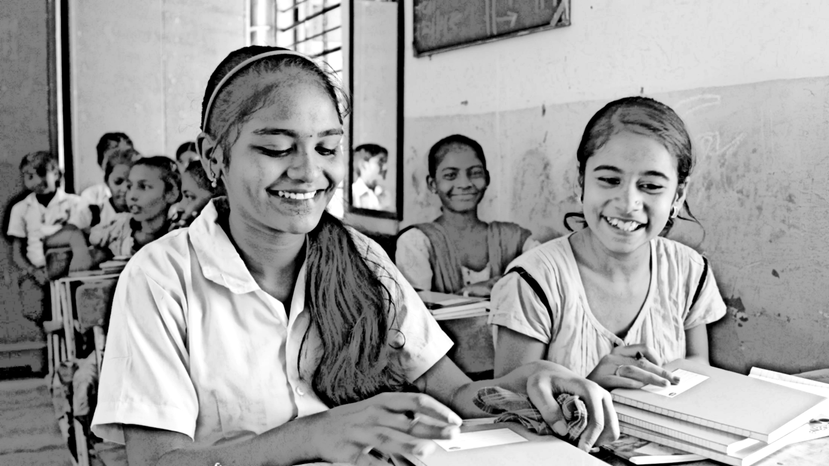

Our ambitions have always extended beyond business,
towards creating lasting value for the communities around us.

Slide 22
Doing our bit. Every single year.
The Gateway Foundation operated by the CB Gemawat Charitable Trust carries the same long-term vision beyond our businesses.
Blanket distribution.
Winter drives before the coldest weeks, for those without shelter. 25,000+ blankets distributed over two decades.
Footwear distribution.
Summer drives, for children who step out barefoot and risk injury and infection. 40,000+ pairs distributed over two decades.
Blood donation camps.
Camps at regular intervals through the year, where our teams give what they can. 10,000+ units collected over two decades.
Food and old-age drives.
Food drives, medicine, and support for old-age homes, run through the year.
Children in school.
School fees funded for underprivileged children. 130+ supported as of 2026, more than 90 of them girls.
In all.
Half a million lives touched over two decades, across these drives and others.

Slide 23
The Organization at a glance.
RECOGNIZED AS
Gateway Group
FOUNDED
1997, Ahmedabad, India
OWNERSHIP
Privately held; the same founders since 1997
FINANCIAL POSTURE
Zero debt, no private funding
GROUP
40+ operating companies; two publicly listed
THE GATEWAY WAY
Engineering · Strategy · Capital · Reach & Network · People · Values
BRILLIANT TEAM
2,000+ professionals from 14 nationalities
PRESENCE
15 countries; dual headquarters in the Netherlands and India
CERTIFICATIONS
ISO 9001:2015 · ISO 27001:2022 (Alcumus ISOQAR, since 2016)
NETHERLANDS HQ
Maria Montessorilaan 5, 2719 DB Zoetermeer · +31 (0) 79 3200 980
INDIA HQ
8th Floor, Corporate House, Bodakdev, Ahmedabad 380054 · +91 79 2685 2554
CONTACT
gateway@thegatewaycorp.com · www.thegatewaycorp.com
Notes:
The page a procurement system actually ingests. Every field is current as of August 2026; the contact line routes to the group, which routes to the right company.

Slide 24
Our Credo.
These teachings shaped our success and continue to guide who we are today.
Qualification-to-Education
“What can I get”-to-“What can I give”
Teaching & studying-to-Learning & realisation
Self-centred success-to-Selfless accomplishments
Indifference & inaction-to-Bold initiative & decisive action
Casualness & mediocre approach-to-An indomitable urge to excel
External examination & certification-to-Self-examination & satisfaction
Employment as mere job & salary-to-A great opportunity to express oneself
Forced upgradation of quality-to-An unflinching mission to serve
Competitive rivalry-to-Support & collaboration
Reward-induced motivation-to-Limitless self-motivation
Excuses & escapism-to-Accountability & “taking charge”
Policed discipline-to-Principle-bound self-discipline
Knowing & doing-to-Performing & achieving
“I can’t”-to-“I can”
Mere living-to-Living by leaving a legacy
Service & means of life-to-Serving & meaning to life
By Prof. M.S. Pillai
NETHERLANDS
INDIA
CONTACT
Maria Montessorilaan 5
2719 DB Zoetermeer
+31 (0) 79 3200 980
8th Floor, Corporate House, Bodakdev
Ahmedabad 380054
+91 79 2685 2554
gateway@thegatewaycorp.com
www.thegatewaycorp.com
© 1997–2026 The Gateway Corp · All rights reserved
LinkedIn · X · YouTube · Facebook · Instagram

